Slide 1
Example:
Write a Program to calculate Fibonacci series up to the given limit n, print the result to the console.

Slide 2
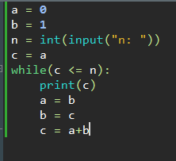
Contd…

Slide 3
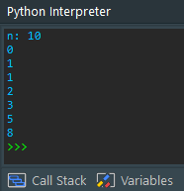
Contd…

Slide 4
Example:
Write a Program to Check whether a given input character is a vowel, or a consonant or not an alphabet.
Print the Result to the console

Slide 5
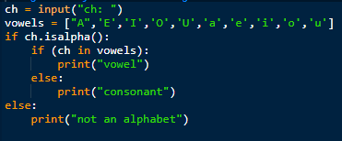
Contd…

Slide 6
Example:
Write a program to print the sum of digits of a number.
For example: 1234 is a number, then the sum of digits is 1+2+3+4=10

Slide 7
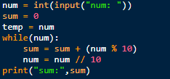
Contd…

Slide 8
Steps:
Input:
num = int(input("num: ")):- takes user input and stores it in the variable num. The user is prompted to enter an integer.
Variable Initialization:
sum = 0: Initialize a variable sum to 0. This variable will be used to store the sum of the digits.
temp = num: Create a temporary variable temp and set it equal to the value of num. This is done to preserve the original value of num for later use.
While Loop:
while(num):- This is a while loop that runs as long as num is not equal to 0. It iterates through the digits of the number one at a time.

Slide 9
Inside the Loop:
sum = sum + (num % 10): In each iteration, the program takes the last digit of num by using the modulo operator % with 10 (num % 10). This operation extracts the rightmost digit of num.
The extracted digit is added to the sum. This step accumulates the sum of all the digits.
num = num // 10: After extracting the rightmost digit, it is removed from num by performing integer division by 10 (num // 10). This shifts the number one place to the right, effectively eliminating the last digit.

Slide 10
Printing the Sum:
print("sum:", sum): Once the while loop has processed all the digits of the original number, it prints the sum of those digits.
We breaks down the input number into its individual digits, adds them together, and prints the sum.
This is done by repeatedly extracting the rightmost digit using modulo and then removing it from the number by performing integer division by 10.
This process continues until all digits have been processed, and the sum is calculated.

Slide 11

Example:
Write a Program to print Pascal’s triangle of n rows.

Slide 12
Contd…
Pascal's Triangle is a triangular array of numbers in mathematics with many interesting properties and applications.
To construct Pascal's Triangle:
1. Start with the number 1 at the top.
2. In each subsequent row, place a 1 on both ends.
3. To calculate the numbers in the interior of the row, add the two numbers directly above them from the previous row.

Slide 13
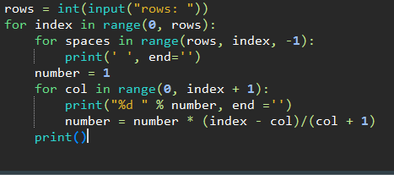
Contd…

Slide 14
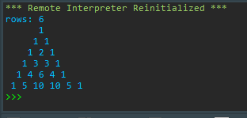
Contd…

Slide 15
Steps:
Input:
rows = int(input("rows: ")): This line takes user input to determine the number of rows to be printed in Pascal's Triangle.
Outer Loop:
for index in range(0, rows):- This is an outer loop that iterates through the rows of Pascal's Triangle. The loop runs from 0 to rows-1.
Printing Leading Spaces:
for spaces in range(rows, index, -1):- This loop is used to print leading spaces before each row. The number of leading spaces decreases as we move down the rows, and it ensures that the triangle is centered when printed.

Slide 16
Contd…
Number Calculation and Printing:
number = 1:
Initialize a variable number to 1. This variable will store the values to be printed in each row of the triangle.
for col in range(0, index + 1):- This loop is used to calculate and print the numbers in the current row of Pascal's Triangle.
print("%d " % number, end = ''): Prints the current value of number followed by a space.
The end = '' argument is used to prevent the print function from adding a newline after each number.
number = number * (index - col) / (col + 1): Calculates the next number in the row using the binomial coefficient formula. It takes into account the previous value of number, the current column col, and the current row index.

Slide 17
Contd…
Print Newline:
print(): After printing all the numbers in the current row, this line prints a newline character to move to the next row.

Slide 18
Example:
Take three inputs a, b, c as inputs. Write a program to find largest of given three numbers and print the result to the console.
Note: Use Split() function to saparate user given data based on (,)

Slide 19
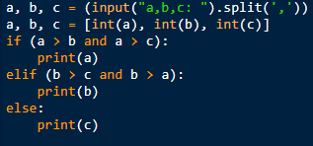
Contd…

Slide 20
Example
Write a program to find whether a number is Prime of not.
Prime Number:
A prime number is a natural number greater than 1 that has no positive divisors other than 1 and itself.

Slide 21
Contd…
Hint:-
In the given program, it iterates through values of i from 2 to half of the input number and checks if any of these values evenly divide the input number.
If any divisor is found, the number is not prime, and the program exits the loop.
If no divisors are found, and the input number is greater than 1, it is considered a prime number.

Slide 22
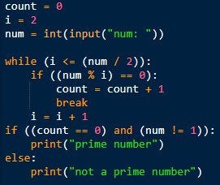
Contd…

Slide 23
Steps:
Initialization:
count = 0: This variable will be used to count the number of divisors found for the input number.
i = 2: We start the loop with i initialized to 2, as 1 is not considered a prime number.
num = int(input("num: ")): This line takes user input for the number to be checked.
While Loop:
while (i <= (num / 2)):-
This loop runs as long as i is less than or equal to half of the input number. This is because, in the worst case, the largest factor of a number (other than itself) is at most half of the number.

Slide 24
Contd…
If Statement Inside the Loop:
if ((num % i) == 0):-
This condition checks if num is divisible by i without leaving a remainder. If this condition is true, it means that i is a divisor of num, and the number is not prime.
count = count + 1: :- If i is a divisor, the count variable is incremented by 1 to keep track of the number of divisors found.
break: The break statement is used to exit the loop as soon as a divisor is found. There is no need to continue checking other values of i once a divisor is found.

Slide 25
After the Loop:
if ((count == 0) and (num != 1)):
This condition checks if count is still 0 (meaning no divisors were found) and if the num is not equal to 1. Prime numbers are defined as greater than 1, so this condition ensures that 1 is not considered prime.
print("prime number"): If the condition is met, the program prints "prime number," indicating that the input number is prime.
If the condition is not met (i.e., if count is not 0 or num is 1), the program prints "not a prime number," indicating that the input number is not prime.

Slide 26
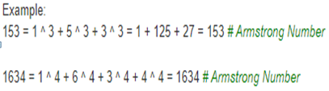
Armstrong Number

Slide 27
Contd…
Write a Program to find whether the given number is Armstrong number or not and print the result to the console.

Slide 28
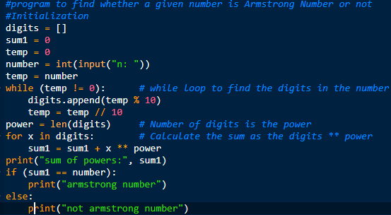
Contd…

Slide 29
Contd…
Hint:-
In this program, we will extracts the digits of the input number, calculate the sum of each digit raised to the power of the number of digits, and compares the result with the original number to determine whether it's an Armstrong number or not.

Slide 30
Contd… Steps:
Initialize variables:
digits: An empty list to store individual digits of the input number.
sum1: A variable to store the sum of the digits raised to the power.
temp: A temporary variable to hold a copy of the input number.
number: Accepts user input as an integer.

Slide 31
Contd…
temp = number: -makes a copy of the input number in the variable temp so that the original number can be preserved for comparison later.
while (temp != 0):- while loop that runs as long as temp is not equal to 0.
It extracts the digits of the number one at a time and appends them to the digits list.
It does this by repeatedly dividing temp by 10 and taking the remainder, which is the last digit of the number.
The digit is then added to the digits list, and temp is updated by integer division by 10 to remove the last digit.

Slide 32
Contd…
power = len(digits):-
After the loop, the power variable is set to the length of the digits list. This represents the number of digits in the original number.
for x in digits:-
This is a for loop that iterates through each digit in the digits list.
sum1 = sum1 + x ** power:-
For each digit x, it raises x to the power of power and adds the result to the sum1 variable. This step calculates the sum of the digits raised to the power of the number of digits.

Slide 33
Contd…
print("sum of powers:", sum1):-
prints the sum of the digits raised to the power of the number of digits.
if (sum1 == number):-
checks whether sum1 is equal to the original number. If they are equal, it means that the number is an Armstrong number, and it prints "armstrong number." Otherwise, it prints "not armstrong number."

Slide 34
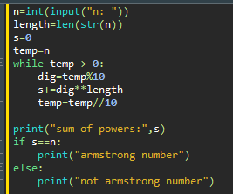
2nd way: Armstrong number

Slide 35

Example: Left shift and Right shift

Slide 36

Contd…

Slide 37
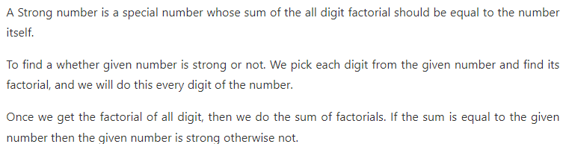
Strong Number

Slide 38
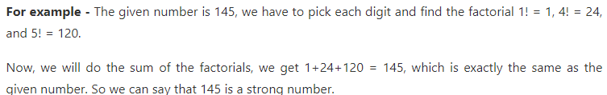
Contd…

Slide 39
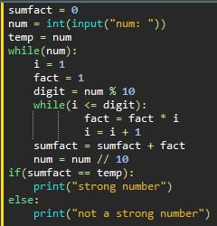
Contd…

Slide 40
Contd…
sumfact = 0: Initialize the sumfact variable to store the sum of factorials.
num = int(input("num: ")): Read an integer input from the user.
temp = num: Store the original input value in the temp variable for later comparison.
The code then enters a while loop to process each digit of the input number.

Slide 41
Contd…
while(num):- This loop continues until num becomes zero (i.e., all digits have been processed).
i = 1:- Initialize a variable i to 1 for calculating the factorial of a digit.
fact = 1:- Initialize a variable fact to 1 to calculate the factorial of the current digit.
digit = num % 10: Extract the last digit of num.
A nested while loop calculates the factorial of the current digit and updates the fact variable accordingly.
sumfact = sumfact + fact:
Add the factorial of the current digit to the running sum of factorials. f. num = num // 10: Remove the last digit from num to process the next digit.

Slide 42
Contd…
After processing all digits, the code checks whether sumfact is equal to the original input value temp.
If sumfact is equal to temp, it prints "strong number"; otherwise, it prints "not a strong number."

Slide 43
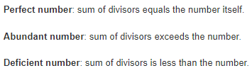
Perfect Number

Slide 44



Example:

Slide 45
Write a program to determine whether the number is Perfect, Abundant and Deficient

Slide 46
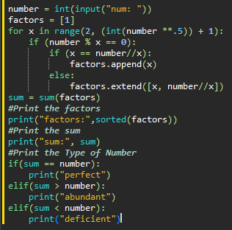
1ST WAY:-

Slide 47
Steps:-
number = int(input("num: ")): Read an integer input from the user.
factors = [1]: Initialize a list called factors with the value 1 because 1 is always a factor of any number.
for x in range(2, (int(number **.5)) + 1): Iterate through numbers from 2 to the square root of the input number (inclusive). This loop is used to find factors of the input number efficiently.
if (number % x == 0): Check if x is a factor of the input number (number). If the remainder of the division is zero, it means x is a factor.
a. If x is equal to number // x, it means the factor is a perfect square factor. In this case, add x to the factors list.
b. Otherwise, if x is not equal to number // x, add both x and number // x to the factors list.

Slide 48
Contd…
sum = sum(factors): Calculate the sum of all factors found in the previous steps and store it in the sum variable.
print("factors:", sorted(factors)): Print the factors in sorted order.
print("sum:", sum): Print the sum of the factors.
Determine the type of number based on the comparison between the sum of factors and the original number:
If sum is equal to number, the number is classified as "perfect" because the sum of its factors equals itself.
If sum is greater than number, the number is classified as "abundant" because the sum of its factors exceeds itself.
If sum is less than number, the number is classified as "deficient" because the sum of its factors is less than itself.

Slide 49
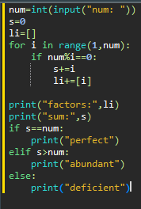
2nd way:

Slide 50
Steps:
We will take an integer input from the user and stores it in the variable num.
We initializes a variable s to 0. This variable will be used to calculate the sum of the factors of num.
We initialize an empty list li to store the factors of num.
Then, iterates through the numbers from 1 to num - 1 using a for loop.

Slide 51
Contd…
For each iteration, it checks if num is divisible by i (i.e., num % i == 0). If it is, then i is a factor of num, so it adds i to the sum s and appends i to the li list.
After the loop, it prints the factors of num and the sum of those factors.
It then checks whether the sum of factors (s) is equal to num. If it is, it prints "perfect." If s is greater than num, it prints "abundant." Otherwise, it prints "deficient."

Slide 52



Contd…

